Slide 1
AISA- Achievement and Opportunity
Lona Running Wolf and
Crystal Armstrong, PhD

Slide 2
Research Question
In Montana schools and communities, what factors influence the American Indian student achievement gap?
Which factors do education stakeholders believe are the driving factors in the achievement gap?
Do those factors vary for students who attend school on-reservation versus those who attend off-reservation?
Where do education stakeholders believe impact can be made to close the achievement gap?

Slide 3
Methods
10 Focus groups- 42 total participants from 15 different communities
On and off-reservation participation
Purposive sampling- regional, role, size factors
Zoom focus groups
Questions about achievement gap, on/off reservation differences, student perceptions, and imagining without barriers
Transcribed and organized into 1799 total comments, comprised of 78 topics
Grouped into 15 themes within 5 overarching categories

Slide 4
Categories
 | Frequency
Culture and the Family | 780
Pedagogy, Curriculum, and Instruction | 539
School System | 441
Student Learning | 709
Trauma and Student Identity | 409
Total | 2878

Slide 5
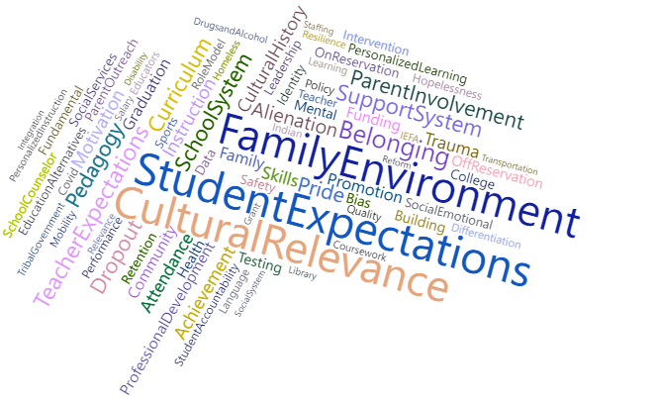
Themes

Slide 6
Main Takeaways
Participant comments indicated a 40/60 split in perceptions about the achievement gap. 40 percent of comments pertained to factors out the school- community, family, geography, and other external things. 60 percent of comments were internal to the school experience.
In schools, the importance of Indian educators cannot be downplayed. They are mentors, role models, and increase curricula relevance. Students need to see teachers who look like them.
Implicit/explicit bias from educators continues to be noticed by students.
Stakeholders also called for revisiting the role of the school counselor and ways to promote social emotional learning.
Personalized learning: stakeholders see a need to make learning relevant, adaptable, and self-paced. This includes an increased focus on CTE, alternative education programs, or alternative graduation requirements. They also call for examining perceptions about achievement (incl. social promotion) and attendance- which are cited frequently in the dataset in relation to dropout

Slide 7
Main Takeaways Continued
Trauma is interwoven throughout the dataset—both generational trauma originating inside the home and historical trauma. Participants advocated strongly for programs and training targeting trauma, acknowledgement of the impacts of trauma, and genuine efforts to acknowledge historical trauma connected to education.
When students see their culture thriving, positive identity, well-being, and achievement are more readily formed and supported. Estrangement from culture may impact drop out. Few cultural ties to testing also lead to a student disconnect with assessments.
Helping students develop an identity that is built of a sense of belonging to community and culture improves student well-being. Feelings of student alienation and hopelessness are barriers to positive identity formation- impacting this well-being

Slide 8
Next Steps
Large scale survey
  Representation from roles, regions, and sizes
  Feedback prior to execution
  Consultation with Indigenous scholars on findings
  Full technical report (incl. methodology) and condensed discussion of findings available at http://opi.mt.gov/Leadership/Data-Reporting/Research-Portal#9965311336-culture--schools-american-indian-perspectives-on-the-american-indian-student-achievement-gap
  For questions on the focus groups, methods, or findings, please contact:
  Lona Running Wolf at Lona.RunningWolf@mt.gov or
  Nicole Frieling at Nicole.Frieling@mt.gov

